Slide 1
CSC 706: Homework 1
By: Robert Kigobe, Dominic Klusek, Novichenko konstatin

Slide 2
Introduction
OpenGL is a cross-language, cross-platform application programming interface for rendering 2D and 3D vector graphics.
It contains several primitive shapes which contains primitives which can be used and manipulated to create a larger number of shapes.
Its versatility has made it one of the most popular graphics library for applications such as computer-aided design (CAD), virtual reality, scientific visualization, information visualization, flight simulation, and video games.

Slide 3
Part 1: Playing with primitives
The first part focuses around creating shapes of vary sizes, colors, gradients, and masks using primitives.
The primitives built into OpenGl include GL_POINTS, GL_LINES, GL_LINE_LOOP, GL_LINE_STRIP, GL_TRIANGLES, GL_TRIANGLE_STRIP, and the GL_TRIANGLE_FAN.
These primitives can be a solid color, have a gradient applied by changing the color of a corner.
Masks can be applied to selectively select certain pixels to show; this may make the shape hard to see, so creating a non-mask copy of a different color behind the masked shape could be useful to be able to see the masked shape.

Slide 4
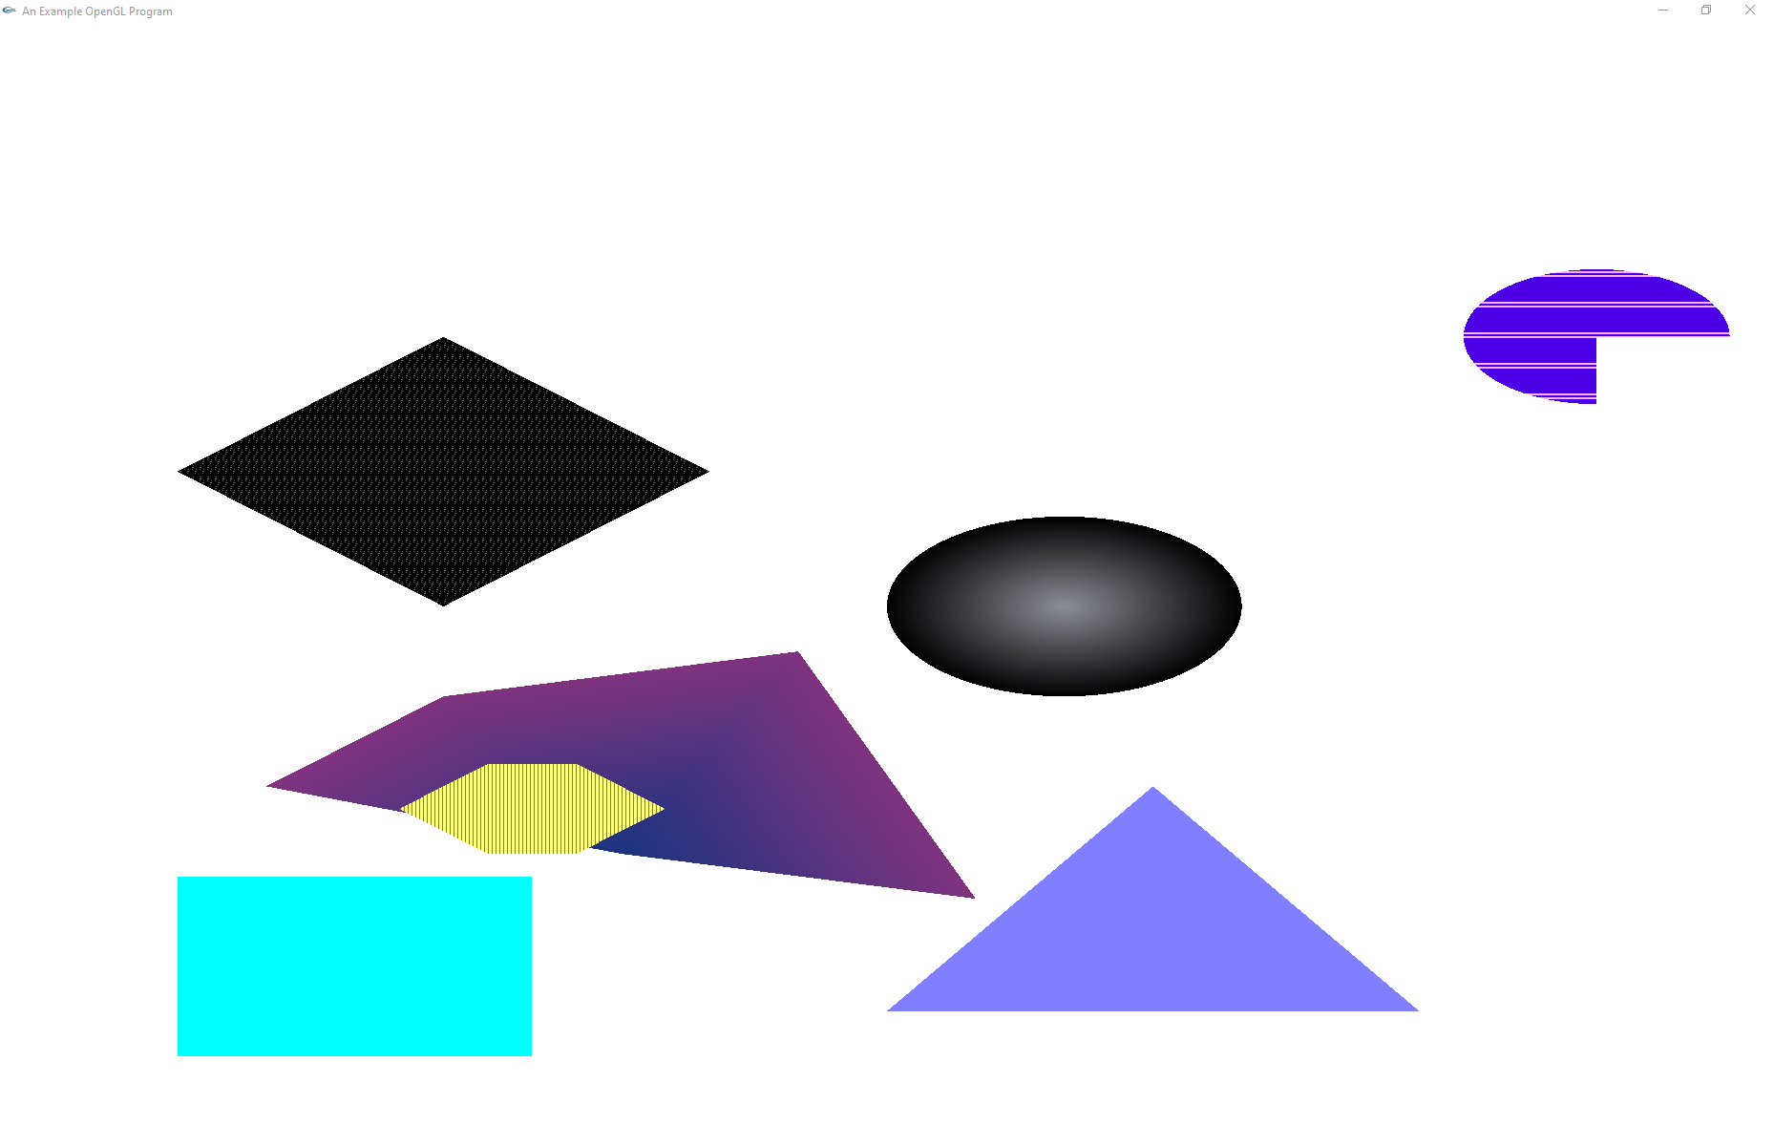
Part 1 result

Slide 5
Part 2: drawing a neighborhood
The second part focuses on applying our knowledge of primitives to create a meaningful image; a neighborhood.
To create a neighborhood we need a sky, a landscape, a road, some houses, and maybe some trees.
Each of these parts were separately created to make the whole process easier to manage.
We explored the idea of creating a function to create a structure of certain dimensions seamlessly.
We also explored the idea of randomly generating some parts using random number generation to offset vertices.

Slide 6
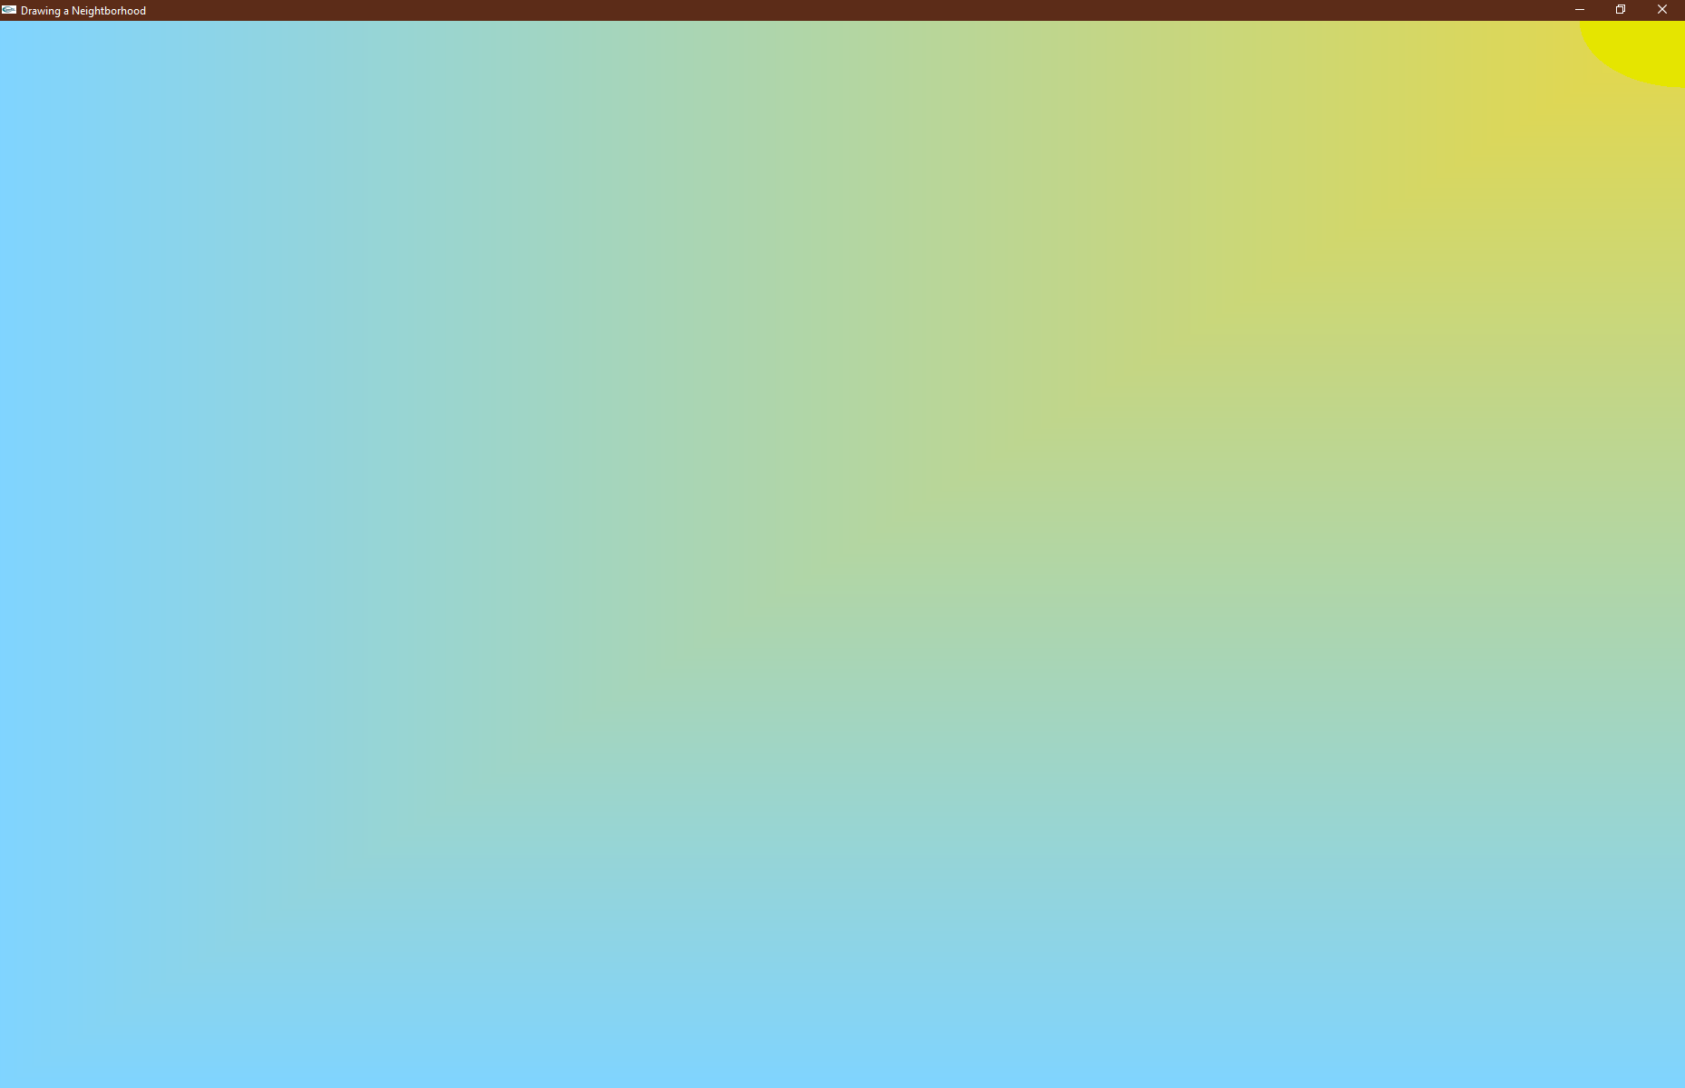
Part 2: The Sky
We created the sky by drawing a blue polygon, with a yellow corner.
We also added a yellow circle to represent the sun.
Initially the gradient was too strong; to counteract this, we extended the world, and then clipped it to a more reasonable amount.

Slide 7
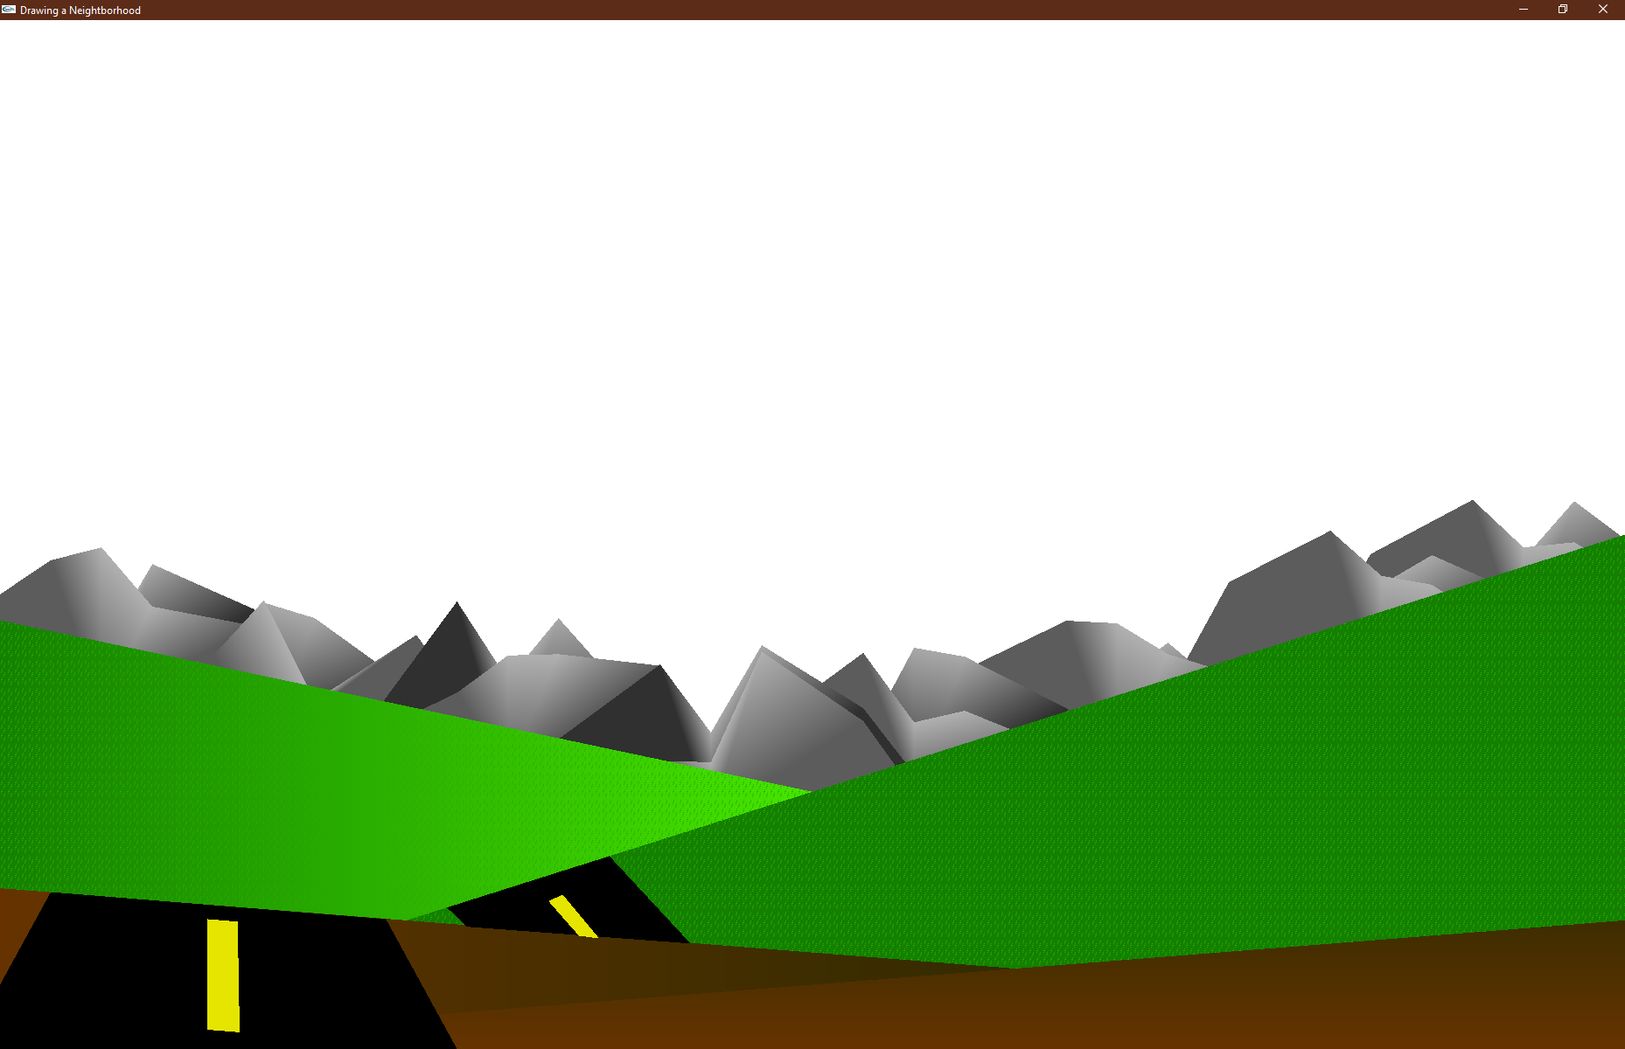
Part 2: The landscape
The landscape is created using multiple primitives.
The mountains are a series of randomly generated GL_TRIANGLE_FANS, each set consists of a lighter and darker mountain; each with an opposing gradient applied.
The grass and dirt are GL_POLYGONs with a gradient, to create the illusion of light, and shadows.
Polygon stippling was applied to the grass to make it look more like grass, but it is hard to see in this image.
The road and road markings are GL_POLYGONs.

Slide 8
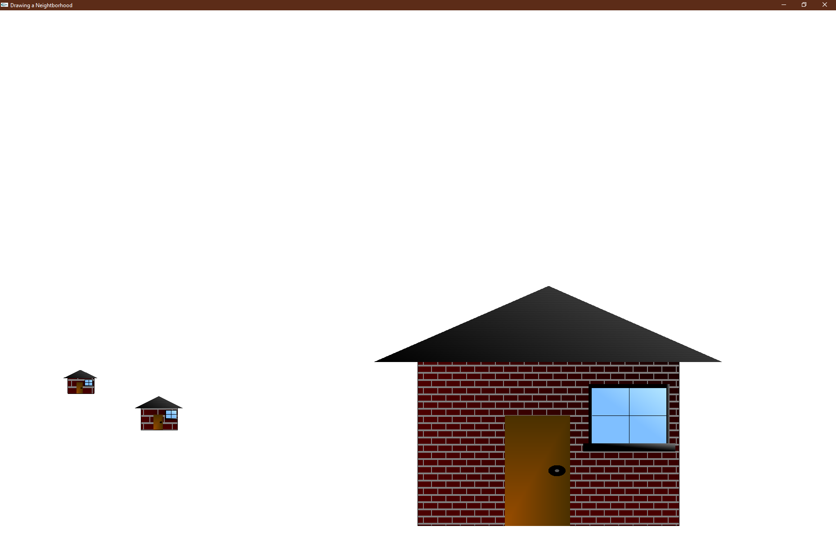
Part 2: the houses
The houses are created using a function which takes in a set of coordinates, and dimensions.
The windows, door, and roof are all drawn proportional to the dimensions, and required quite a bit of fumbling with fractions to get correct.
The provided brick mask and a roof mask were applied which did not work as well for the smaller houses but worked quite well on the larger house.
Gradients were applied to mimic shadows and light.

Slide 9
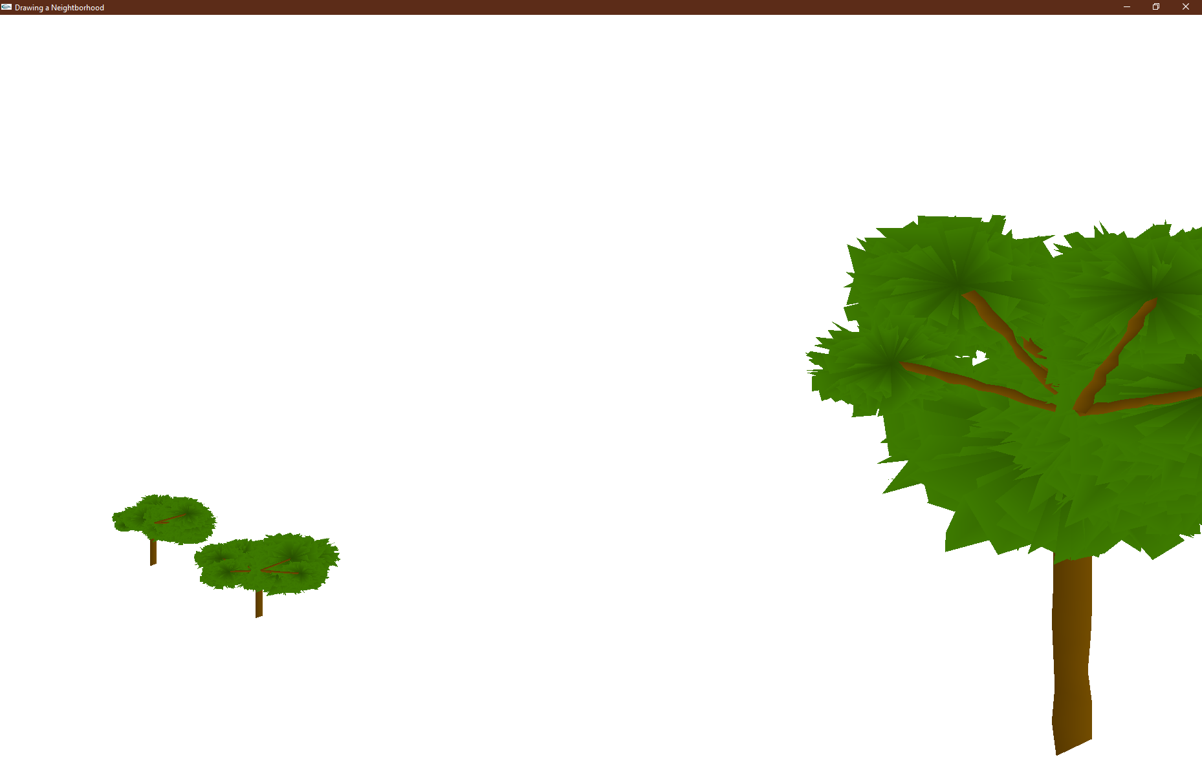
Part 2: Trees
The trees have a bit of random generation to improve realism and make creating trees easier,
The trunk is a GL_TRIANGLE_FAN with random offsets in the x direction.
The leaves are a circle made of GL_POLYGON, with random offsets to each vertex.
The branches are made like the trunk except we calculate the slope from the trunk to the center of the leaves.

Slide 10
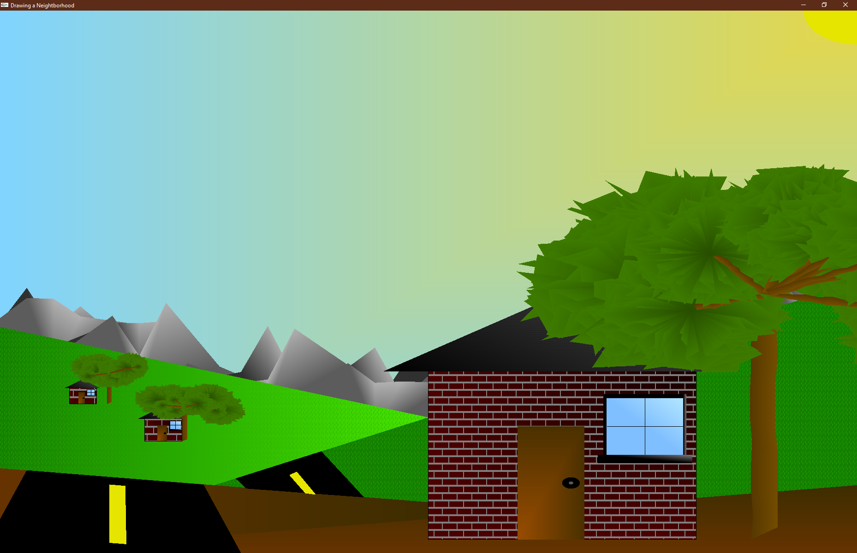
Part 2: Putting it all together
The complete image.

Slide 11
conclusions
This introduction to OpenGL has exposed us to a large amount of the versatility and usability in its API.
The first part gave us basic knowledge of primitives and eased us into how to create shapes of different sizes, and colors.
The second part was more complex (with the create of a functions to create homes, random mountains, and random trees), but was a good way for us to learn house to create code reusable code, and add more variety to our drawings.

